Slide 1

Integrating Power BI
with Azure Synapse Analytics Serverless SQL Pools

Slide 2

Session
Azure Synapse Analytics
The Lakehouse
Demo
Power BI &
Data Lake Partitioning
Serverless SQL Pools

Slide 3

Azure Synapse Analytics
Dedicated SQL
Serverless SQL
What is Synapse?
Import data into a large-scale database
Query data in Azure Storage, Cosmos DB, and Dataverse
The Pools
Spark
Data Explorer
Run Data Engineering and Machine Learning workloads
Analyse log and telemetry data using KQL
Pipelines
Azure Cloud Analytics service which brings Data Warehousing, Big Data Analytics, and Data Integration into a single platform
Data Integration
Orchestrate data movement and transformation
Power BI
Analytics
Create Datasets and Reports within Synapse Studio
Development
Synapse Studio
Web Studio for developing SQL, Pipelines, Notebooks

Slide 4
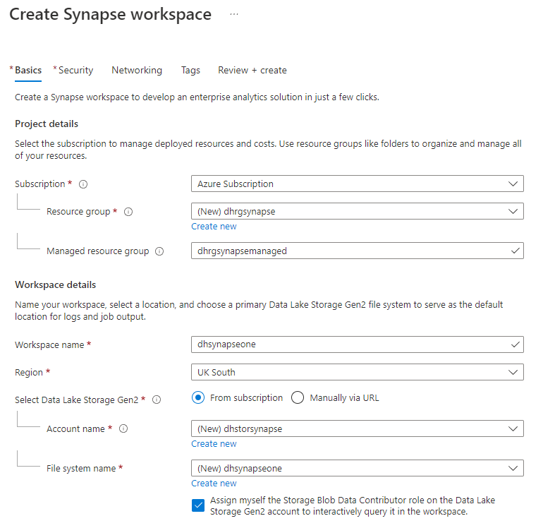
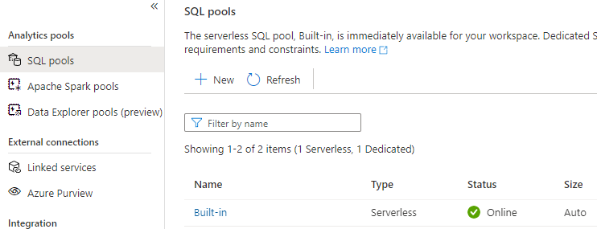
Creating a Synapse Analytics Workspace
Creating a Synapse Analytics Workspace via Azure Portal
As part of provisioning a new Synapse Analytics Workspace, a Serverless SQL Pools “Built-in” service is automatically created ans is immediately available

Slide 5



Serverless SQL Pools
Azure Storage
Azure Data Lake Gen1 & Gen2
Write
Query external data in Azure Storage, Cosmos DB and Dataverse
SQL Clients
Cosmos DB
Read
Familiar SQL objects
Databases
Stored Procedures
DMVs
Views
External Tables
Serverless SQL Pools
Dataverse
~$5 per 1TB Data Processed (Write/Read)
Serverless SQL Pools are always on, no need to resume/pause/stop
Resources are allocated automatically, no scaling options
It is not a blazing fast interactive database engine

Slide 6


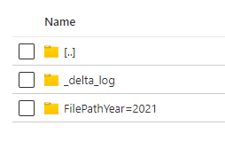

The Lakehouse
Flexiblity of the Data Lake with features available in typical Data Warehouse technology
Transactions
Delta File Format
Supports consistency when writing and reading data
Open-source Storage format
Based on Apache Parquet
Schema Enforcement
Supports batch and streaming data loads
Ensuring schema consistency when writing data
Can INSERT, UPDATE, & DELETE data
Connection Support
Ability to connect various compute engines and tools

Slide 7


Lakehouse Architecture
Serverless SQL Pools can play a part in a Lakehouse architecture to serve data from the Data Lake to Power BI
Data Transformation
Source Data
Serverless SQL Pools
Power BI
Raw
Different formats
Cleansed
Parquet, Delta
Curated
Delta
Data Lake

Slide 8
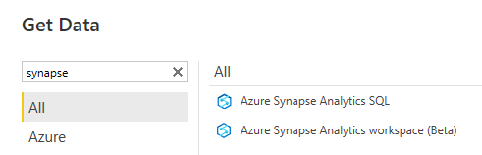
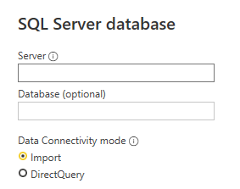
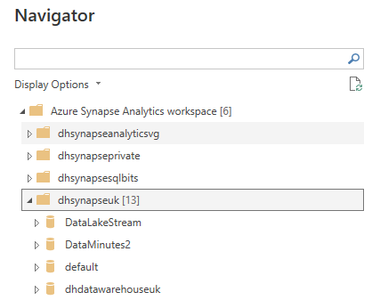
Connecting to Synapse Analytics
There are 2 connectors in Power BI Desktop
Azure Synapse Analytics SQL
Azure Synapse Analytics workspace (Beta)
DirectQuery & Import
Import only

Slide 9
Tips for Power BI & Serverless SQL Pools
Use a small dataset to test with, you can swap out the location in the Serverless SQL Pools View
Use Partitioning in the Data Lake to your advantage and configure filtering and Incremental Refresh
If (if…) using DirectQuery then use query reduction settings in Power BI
General Serverless SQL Pools Tips
Try and ensure Power BI, Synapse Analytics, and Azure Storage are in the same region
Use Parquet and Delta file format where possible
Assign the smallest data types possible
File sizes evenly ranged from 100MB to 10GB each

Slide 10

Data Lake Partitioning & Power BI
We can use a SQL metadata function filepath() to “partition prune” when querying data in Azure Storage
We can use this metadata in Power BI to filter and setup Incremental refresh
Data Lake
Serverless SQL Pools View
Power BI Query
\EventYear=2022\
\EventMonth=03\
\EventDate=2022-03-01
\EventDate=2022-03-02
\EventDate=2022-03-03
CREATE VIEW…
AS
SELECT filepath(1) AS EventYear,
filepath(2) AS EventMonth,
filepath(3) AS EventDate,
…
SELECT…
…WHERE EventDate = ‘2022-03-02’
EventDate is the 3rd level in the folder hierarchy

Slide 11
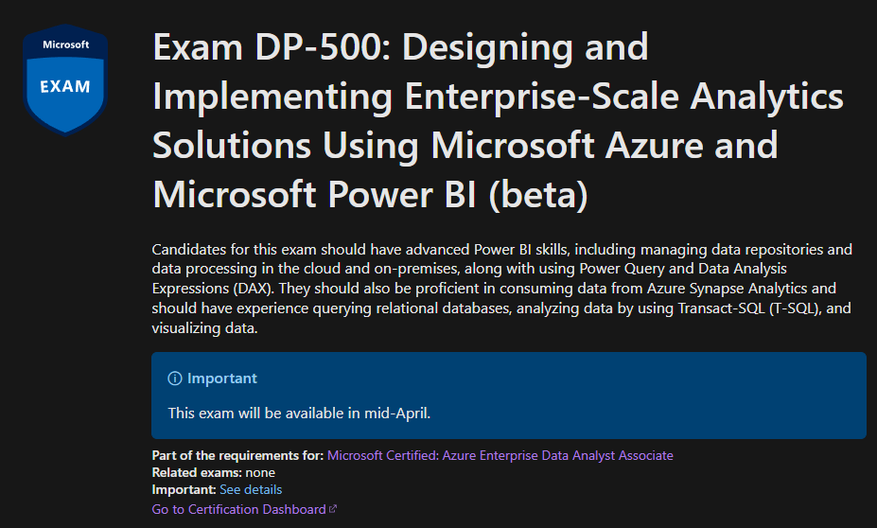
New Certification
Available ~mid-April
Covers:
Power BI
Azure Purview
Azure Synapse Analytics
Azure Data Lake Gen2
DP-500: Designing and Implementing Enterprise-Scale Analytics Solutions Using Microsoft Azure and Microsoft Power BI (beta) - Learn | Microsoft Docs

